Slide 1

Big Data Applied Algorithms
Lecture 5
Rong-Hua Li
School of Computer Science & Technology
Beijing Institute of Technology

Slide 2
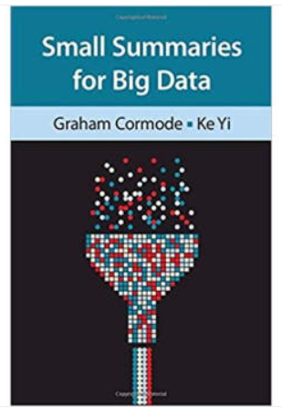
Course Information
Grade: 50% final exam, 50% Homework
Recommended Books (PDF available: http://dimacs.rutgers.edu/~graham/ssbd.html)

Slide 3
This lecture
Distance-based graph mining
All-Distances Sketches
Applying All-Distance sketches to mining tasks

Slide 4
















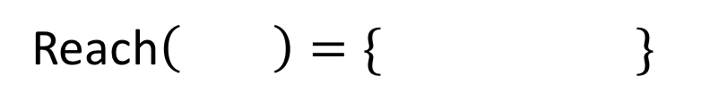
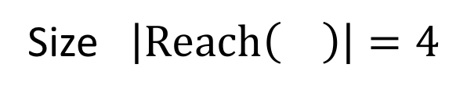
Review: Reachability Set of
Reach$\left( \right)=\{ \}$
Size $\left|Reach\left( \right)\right|=4$

Slide 5


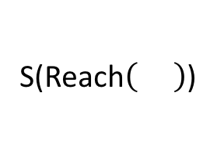
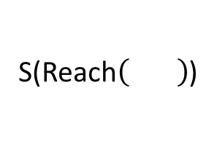
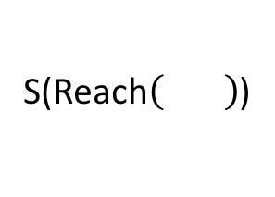
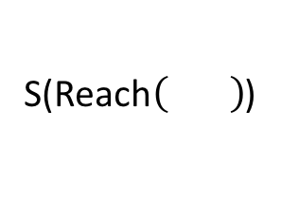
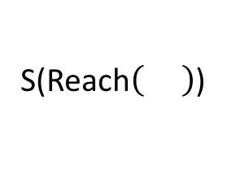
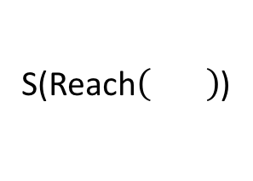
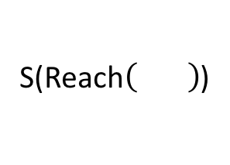
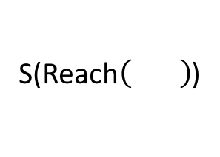
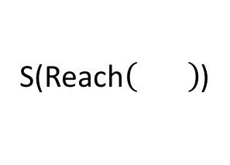
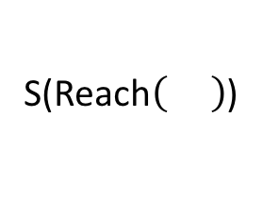
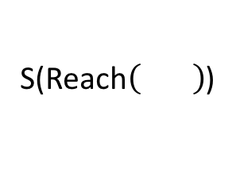
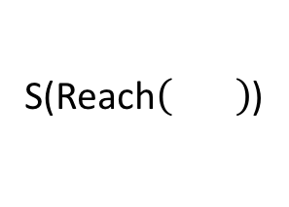
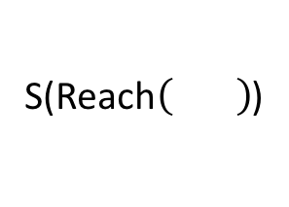
Review: MinHash sketches of all reachability Sets
S(Reach )
S(Reach )
S(Reach )
S(Reach )
S(Reach )
S(Reach )
S(Reach )
S(Reach )
S(Reach )
S(Reach )
S(Reach )
Reach$\left( \right)=\{ \}$
S(Reach )
$S(Reach\left( \right))=$ $\{\left(h\left( \right), \right),\left(h\left( \right), \right)\}$
S(Reach )

Slide 6
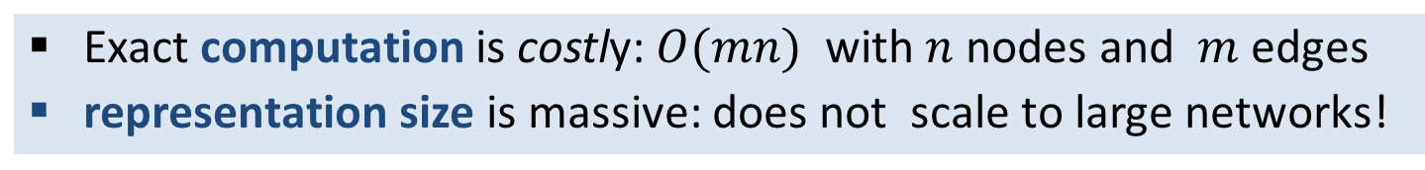
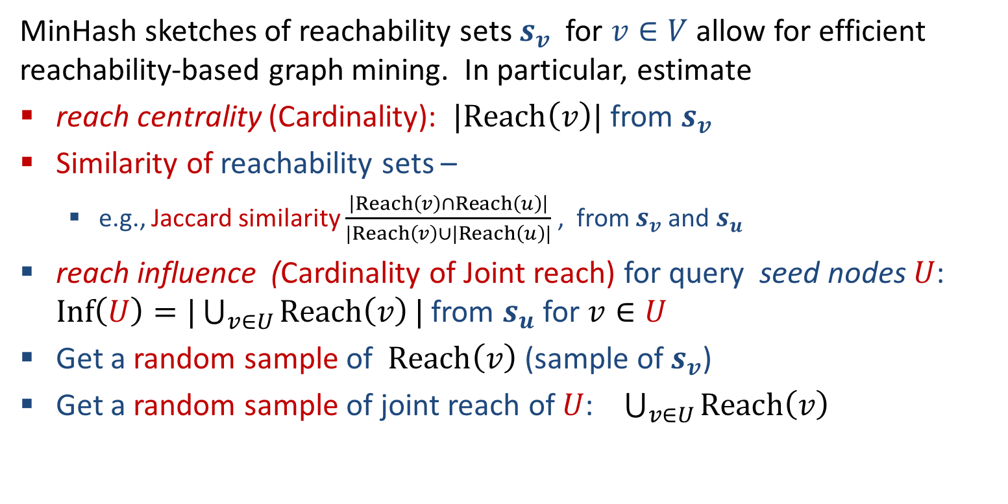
Review: Why sketch reachability sets ?
Exact computation is costly: $O(mn)$ with $n$ nodes and $m$ edges
representation size is massive: does not scale to large networks!
MinHash sketches of reachability sets $s_{v}$ for $v∈V$ allow for efficient reachability-based graph mining. In particular, estimate
reach centrality (Cardinality): $|Reach\left(v\right)|$ from $s_{v}$
Similarity of reachability sets –
e.g., Jaccard similarity $\frac{\left|Reach\left(v\right)∩Reach\left(u\right)\right|}{|Reach\left(v\right)∪|Reach\left(u\right)|}$ , from $s_{v}$ and $s_{u}$
reach influence (Cardinality of Joint reach) for query seed nodes $U$: $Inf\left(U\right)=|\bigcup_{v∈U}{Reach\left(v\right)}|$ from $s_{u}$ for $v∈U$
Get a random sample of $Reach\left(v\right)$ (sample of $s_{v}$)
Get a random sample of joint reach of $U$: $\bigcup_{v∈U}{Reach\left(v\right)}$

Slide 7
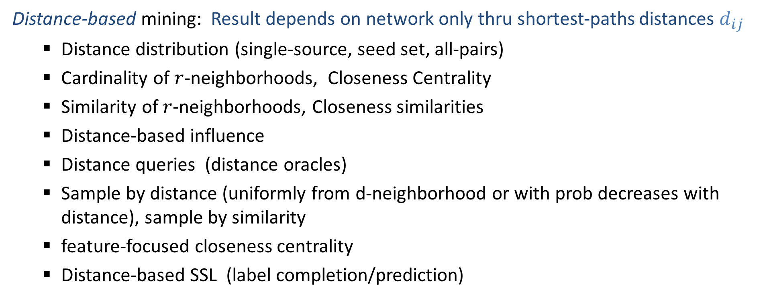
Distance-based graph mining
Distance-based mining: Result depends on network only thru shortest-paths distances $d_{ij}$
Distance distribution (single-source, seed set, all-pairs)
Cardinality of $r$-neighborhoods, Closeness Centrality
Similarity of $r$-neighborhoods, Closeness similarities
Distance-based influence
Distance queries (distance oracles)
Sample by distance (uniformly from d-neighborhood or with prob decreases with distance), sample by similarity
feature-focused closeness centrality
Distance-based SSL (label completion/prediction)

Slide 8









Shortest-path Distance vectors
SP distances:
0
5
6
7
10
10
13
14
15
15
16
17
17
5
1
4
3
6
3
4
4
7
4
10
10
3
5
10
5
3
10
2
10
10
7
5
3
4
6
Exact computation:
Single-source shortest paths (e.g. Dijkstra)
4

Slide 9
Shortest-path Distance vectors
SP distances:
17
17
16
13
7
17
16
13
16
3
1
0
4
5
1
4
3
6
3
4
4
7
4
10
10
3
5
10
5
3
10
2
10
10
7
5
3
4
6
4

Slide 10
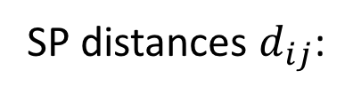
Distance Matrix
SP distances $d_{ij}$:
0
5
6
7
10
10
13
14
15
15
16
17
17
17
17
16
13
7
17
16
13
16
3
1
0
4
. . . . . . . . …
Exact computation:
All-pairs shortest paths
Representation size:
Quadratic
. . . . . . . . …
..…

Slide 11
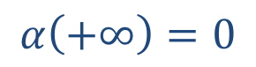
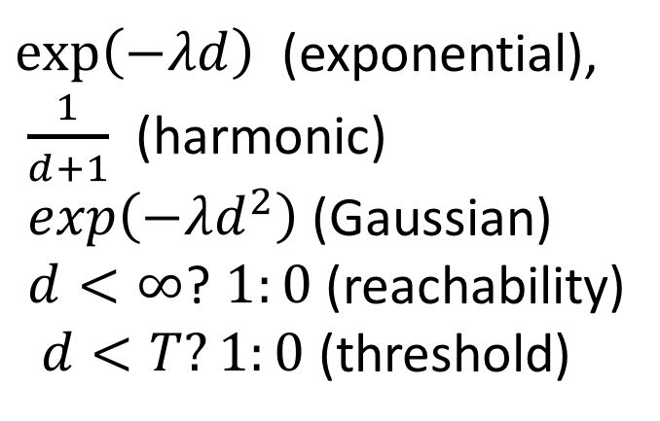
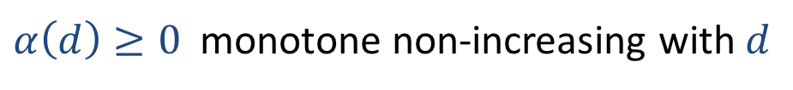
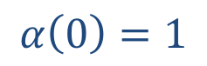

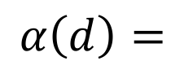
Importance/relevance decays with distance
Decay is specified by a decay (kernel) function $α$
$$α\left(0\right)=1$$
$α\left(d\right)≥0$ monotone non-increasing with $d$
$$α\left(+∞\right)=0$$
$exp\left(−λd\right)$ (exponential),
$\frac{1}{d+1}$ (harmonic)
$exp\left(−λd^{2}\right)$(Gaussian)
$d<∞$? $1:0$ (reachability)
$d<T?1:0$ (threshold)
$$α\left(d\right)=$$
Notes:
Graph can be directed, so it is not a metric space. If a node is not reachable, distance is $+∞$

Slide 12
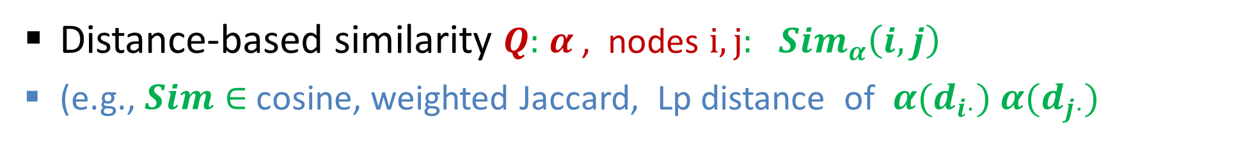
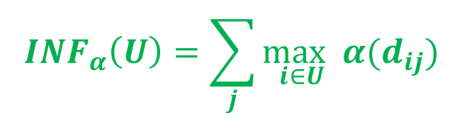
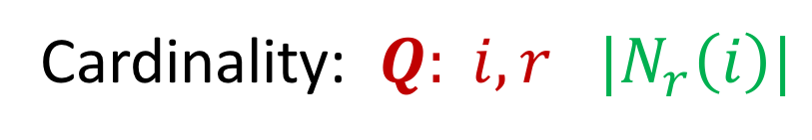
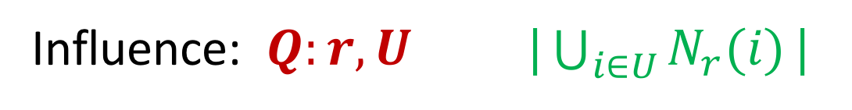
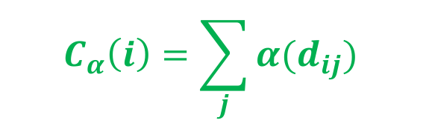
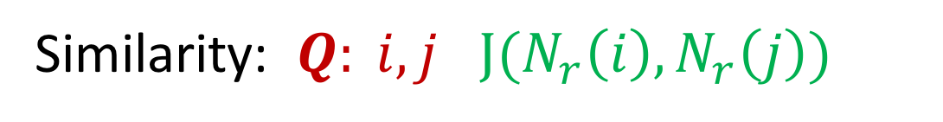
Decayed-Distance-based queries
$r$-Neighborhood of node $i$ ($r>0$) $N_{r}\left(i\right)=\{j∣d_{ij}≤r \}$
Cardinality: $Q: i,r$ $|N_{r}\left(i\right)|$
Similarity: $Q: i,j$ $J(N_{r}\left(i\right),N_{r}\left(j\right))$
Influence: $Q:r,U |\bigcup_{i∈U}{N_{r}(i)}|$
Distance-decay closeness centrality $Q:$Decay (kernel) function $α$ , node $i$
$$C_{α}\left(i\right)=\sum_{j}{α(d_{ij}) }$$
$${INF}_{α}\left(U\right)=\sum_{j}{\max_{i∈U}α(d_{ij}) }$$
Distance-based influence $Q:$ $α$ , seed nodes $U$
Distance-based similarity $Q:$ $α$ , nodes $i,j:$ ${Sim}_{α}\left(i,j\right)$
(e.g., $Sim∈$ cosine, weighted Jaccard, Lp distance of $α(d_{i⋅}) α(d_{j⋅})$

Slide 13
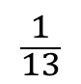
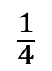
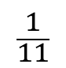
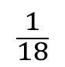
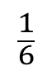
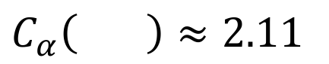
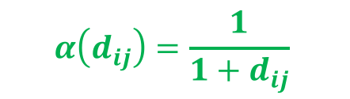
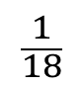
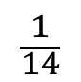
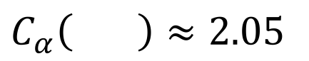
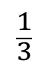
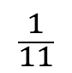
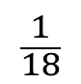
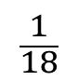
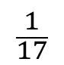
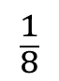
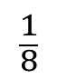
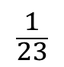
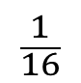









Centrality with decayed distance
$$C_{α}\left(i\right)=\sum_{j}{α(d_{ij})}$$
SP distance vectors:
20
12
22
17
17
15
16
12
2
0
3
4
7
13
14
15
10
0
6
5
7
15
17
16
17
10
$$α\left(d_{ij}\right)={\frac{1}{1+d_{ij}}}^{ }$$
Distance-decay:
$$\frac{1}{21}$$
$$\frac{1}{13}$$
$$\frac{1}{23}$$
$$\frac{1}{18}$$
$$\frac{1}{18}$$
$$\frac{1}{16}$$
$$\frac{1}{17}$$
$$\frac{1}{13}$$
$$\frac{1}{3}$$
1
$$\frac{1}{4}$$
$$\frac{1}{5}$$
$$\frac{1}{8}$$
$$\frac{1}{14}$$
$$\frac{1}{15}$$
$$\frac{1}{16}$$
$$\frac{1}{11}$$
1
$$\frac{1}{7}$$
$$\frac{1}{6}$$
$$\frac{1}{8}$$
$$\frac{1}{16}$$
$$\frac{1}{18}$$
$$\frac{1}{17}$$
$$\frac{1}{18}$$
$$\frac{1}{11}$$
$C_{α}\left( \right)≈2.05$
$C_{α}\left( \right)≈2.11$
Notes:
Fine-tune: say with respect to certain group of nodes or products, possibly weighted. Measure node similarity based on their relation to musicians, certain class or products, etc.

Slide 14





Influence with decayed distances
$${INF}_{α}\left(U\right)=\sum_{j}{\max_{i∈U}α(d_{ij}) }$$
SP distance vectors:
20
12
22
17
17
15
16
12
2
0
3
4
7
13
14
15
10
0
6
5
7
15
17
16
17
10
Distance-decay:
$$α\left(d_{ij}\right)={\frac{1}{1+d_{ij}}}^{ }$$
$$\frac{1}{21}$$
$$\frac{1}{13}$$
$$\frac{1}{23}$$
$$\frac{1}{18}$$
$$\frac{1}{18}$$
$$\frac{1}{16}$$
$$\frac{1}{17}$$
$$\frac{1}{13}$$
$$\frac{1}{3}$$
1
$$\frac{1}{4}$$
$$\frac{1}{5}$$
$$\frac{1}{8}$$
$$\frac{1}{14}$$
$$\frac{1}{15}$$
$$\frac{1}{16}$$
$$\frac{1}{11}$$
1
$$\frac{1}{7}$$
$$\frac{1}{6}$$
$$\frac{1}{8}$$
$$\frac{1}{16}$$
$$\frac{1}{18}$$
$$\frac{1}{17}$$
$$\frac{1}{18}$$
$$\frac{1}{11}$$
$${INF}_{α}\left( , \right)$$
$≈3.64$
$C_{α}\left( \right)≈2.11$
$C_{α}\left( \right)≈2.05$
*Sum of max (Submodular)
Notes:
Fine-tune: say with respect to certain group of nodes or products, possibly weighted. Measure node similarity based on their relation to musicians, certain class or products, etc.

Slide 15









Node labels/features $β(i)$
Some nodes (entities) have associated feature/label”: topic, interest, community, type….
We are interested in
Centrality/influence focused on this feature (similar to the role of teleport probabilities in topic-focused or personalized Page Rank)
Label completion (semi-supervised learning): Predict labels for unlabeled nodes based on graph structure and the few labeled nodes
“Evilness” on [0,1] scale
$β$:
$$1$$
$$0$$
$$0$$
$$0.8$$
$$0.9$$
$$0$$
$$0.1$$

Slide 16

































Centrality to $β$ “Evil”
$$C_{α,β}\left(i\right)=\sum_{j}{α(d_{ij}) β(j)}$$
$β≡evilness in [0,1]$
0.8
0.1
0.1
0.8
1
0.1
0
0
0
0
0.1
0
0.9
$$α\left(d_{ij}\right)={\frac{1}{1+d_{ij}}}^{ }$$
$$α\left(d_{ij}\right)β(j)$$
$$\frac{0.8}{21}$$
$$\frac{0.1}{13}$$
$$\frac{0.1}{23}$$
$$\frac{0.8}{18}$$
$$\frac{1}{18}$$
$$\frac{0.1}{16}$$
$$\frac{0}{17}$$
$$\frac{0}{13}$$
$$\frac{0}{3}$$
0
$$\frac{0.1}{4}$$
$$\frac{0}{5}$$
$$\frac{0.9}{8}$$
$$α\left(d_{ij}\right)β(j)$$
$$\frac{0.8}{14}$$
$$\frac{0.1}{15}$$
$$\frac{0.1}{16}$$
$$\frac{0.8}{11}$$
1
$$\frac{0.1}{7}$$
$$\frac{0}{6}$$
$$\frac{0}{8}$$
$$\frac{0}{16}$$
$$\frac{0}{18}$$
$$\frac{0.1}{17}$$
$$\frac{0}{18}$$
$$\frac{0.9}{11}$$
$C_{α}\left( \right)≈2.05$ “total” centrality
$C_{α}\left( \right)≈2.11$ “total” centrality
$C_{α,β}\left( \right)≈1.24$ “evil” part
$C_{α,β}\left( \right)≈0.29$ “evil” part

Slide 17



































SSL (label prediction)
Only some nodes are labeled, we want to ”predict” labels to other nodes based on closeness
$β≡evilness in [0,1]$
0.8
?
0.1
0.8
?
0.1
0
0
0
?
0.1
0
0.9
$$α\left(d_{ij}\right)={\frac{1}{1+d_{ij}}}^{ }$$
$$α\left(d_{ij}\right)I_{j labeled}$$
$$\frac{1}{21}$$
$$0$$
$$\frac{1}{23}$$
$$\frac{1}{18}$$
$$0$$
$$\frac{1}{16}$$
$$\frac{1}{17}$$
$$\frac{1}{13}$$
$$\frac{1}{3}$$
0
$$\frac{1}{4}$$
$$\frac{1}{5}$$
$$\frac{1}{8}$$
$$α\left(d_{ij}\right)I_{j labeled}$$
$$\frac{1}{14}$$
$$0$$
$$\frac{1}{16}$$
$$\frac{1}{11}$$
$$0$$
$$\frac{1}{7}$$
$$\frac{1}{6}$$
$$\frac{1}{8}$$
$$\frac{1}{16}$$
$$0$$
$$\frac{1}{17}$$
$$\frac{1}{18}$$
$$\frac{1}{11}$$
$C_{α,L}$ centrality to “labeled”:
$$C_{α,L}\left( \right)≈1.61$$
$$C_{α,L}\left( \right)≈0.93$$
Notes:
Can normalize by beta=1 to obtain component of centrality due to evil/good
If only some nodes are labeled, only these nodes get weight 1, which is partioned to evil/good. This can be used for attribute completion.

Slide 18







SSL (label prediction)
Only some nodes are labeled, we want to ”predict” labels to other nodes based on closeness
$β≡evilness in [0,1]$
0.8
?
0.1
0.8
?
0.1
0
0
0
?
0.1
0
0.9
$$α\left(d_{ij}\right)={\frac{1}{1+d_{ij}}}^{ }$$
$$α\left(d_{ij}\right){β\left(j\right)I}_{j labeled}$$
$$\frac{0.8}{21}$$
$$0$$
$$\frac{0.1}{23}$$
$$\frac{0.8}{18}$$
$$0$$
$$\frac{0.1}{16}$$
$$\frac{0}{17}$$
$$\frac{0}{13}$$
$$\frac{0}{3}$$
0
$$\frac{0.1}{4}$$
$$\frac{0}{5}$$
$$\frac{0.9}{8}$$
$$α\left(d_{ij}\right){β\left(j\right)I}_{j labeled}$$
$$\frac{0.8}{14}$$
$$0$$
$$\frac{0.1}{16}$$
$$\frac{0.8}{11}$$
$$0$$
$$\frac{0.1}{7}$$
$$\frac{0}{6}$$
$$\frac{0}{8}$$
$$\frac{0}{16}$$
$$0$$
$$\frac{0.1}{17}$$
$$\frac{0}{18}$$
$$\frac{0.9}{11}$$
$C_{α,L}$ centrality to “labeled”:
$$C_{α,L}\left( \right)≈1.61$$
$$C_{α,L}\left( \right)≈0.93$$
$≈0.23$ “evil part” (14%)
$≈0.24$ “evil part” (26%)
Notes:
Can normalize by beta=1 to obtain component of centrality due to evil/good
If only some nodes are labeled, only these nodes get weight 1, which is partioned to evil/good. This can be used for attribute completion.

Slide 19















Similarity Measures: Local
$sim(i,j)$ depends only on the immediate neighbors of $i,j$
Jaccard: $\frac{|Γ\left(i\right) ∩ Γ\left(j\right)|}{|Γ\left(i\right) ∪ Γ\left(j\right)|}$
Adamic Adar: $\sum_{x ∈ Γ\left(i\right) ∩ Γ(j)}{\frac{1}{\log{|Γ\left(x\right)|}}}$
J( , )= $\frac{2}{9}$
J( , )= $\frac{3}{5}$
AA( , )= $\frac{1}{log 5}$
AA( , )=$\frac{3}{\log{4}}$
Work well for $d_{ij}≤2$, but no distinction when $d_{ij}>2$
Does not handle edge weights
Notes:
Main issue: recall. Also other issues like edge weights (important to capture intensity or timeliness/recency of connection)

Slide 20



Distance-based Similarity: Global
SP distance vectors:
20
12
22
17
17
15
16
12
2
0
3
4
7
13
14
15
10
0
6
5
7
15
17
16
17
10
$$α\left(d_{ij}\right)={\frac{1}{1+d_{ij}}}^{ }$$
Decayed Distances:
$$\frac{1}{21}$$
$$\frac{1}{13}$$
$$\frac{1}{23}$$
$$\frac{1}{18}$$
$$\frac{1}{18}$$
$$\frac{1}{16}$$
$$\frac{1}{17}$$
$$\frac{1}{13}$$
$$\frac{1}{3}$$
1
$$\frac{1}{4}$$
$$\frac{1}{5}$$
$$\frac{1}{8}$$
$$\frac{1}{14}$$
$$\frac{1}{15}$$
$$\frac{1}{16}$$
$$\frac{1}{11}$$
1
$$\frac{1}{5}$$
$$\frac{1}{6}$$
$$\frac{1}{8}$$
$$\frac{1}{16}$$
$$\frac{1}{18}$$
$$\frac{1}{17}$$
$$\frac{1}{18}$$
$$\frac{1}{11}$$
Cosine similarity: $\frac{\sum_{x}{α\left(d_{ix}\right)α\left(d_{jx}\right){ }}}{{\left|α(d_{i}⋅)\right|| }_{2}{|\left|α\left(d_{j}⋅\right)\right|| }_{2}} ≈ 0.18$
Weighted Jaccard: $\frac{\sum_{x}{min α\left(d_{ix}\right), α(d_{jx})}}{\sum_{x}{maxα\left(d_{ix}\right), α\left(d_{ix}\right)}} ≈0.21$
Notes:
Fine-tune: say with respect to certain group of nodes or products, possibly weighted. Measure node similarity based on their relation to musicians, certain class or products, etc.

Slide 21







Distance-based similarity: global (distance decay+topic)
$c_{ij}=α(d_{ij})$ $β(j)$
sim$\left(i,j\right)=\frac{\sum_{h}{β\left(h\right)\min{c_{ih} ,c_{jh}}}}{\sum_{h}{β\left(h\right)max{c_{ih} ,c_{jh}}}}$
weighted Jaccard:
Cosine:
sim$\left(i,j\right)=c_{i⋅}⋅c_{j}.$
$L_{p}$ Distance:
sim$\left(i,j\right)={\left\|c_{i⋅}−c_{j⋅}\right\|}_{p}$

Slide 22






Distance sketching
Exact computation of distance vectors is costly: $O(m log n)$ for single source, $O(mn log n)$ for all pairs ($n$ nodes and $m$ edges)
representation size is quadratic
S(Distances )
0
5
6
7
10
10
13
14
15
15
16
17
17
S(Distances )
17
17
16
13
7
17
16
13
16
3
1
0
4
All-Distance sketches:
A sketch of the distance vector of each node
Allow us to approximate decayed-distance based queries
Sketches are sample-based: Emphasis on closer nodes (smaller distances)
Near-linear computation, small size

Slide 23


All-Distances Sketches (ADSs)
Random hash function $h∼H$ applied to node IDs
Bottom-$k ADS(v)$ : list of node ID and distance pairs $\left(i,d_{vi}\right)$
$i$ $∈$ $ADS\left(v\right)⟺ h(i)$ < k^{th} smallest hash of nodes that are closer to $v$ than $i$
MinHash+ distance dimension (*assume for simplicity here distinct distances)
$ADS\left(v\right)$ is the union over $d>0$ of the MinHash sketches of $N_{d}(v)$
Proof:
If $i∈ADS(v)$ then $h(i)$ must be one of the k smallest in $N_{d_{vi}}(v)$
If $i∈$ MinHashSketch($N_{d}(v)$) then $h(i)$ is one of the k smallest in $N_{d}(v)$
And since $d_{vi}≤d$ it must be one of the k smallest in $N_{d_{vi}}(v)$

Slide 24
ADS example
SP distances:
0
5
6
7
10
10
13
14
15
15
16
17
17
0.77
0.07
0.28
0.49
5
1
3
0.14
4
6
3
4
4
7
4
10
10
3
5
10
5
0.91
3
0.35
2
0.70
10
10
10
7
5
3
4
0.21
0.63
6
4
0.84
Random permutation of nodes
0.56
0.42

Slide 25



ADS example $k=1$: Node with smallest hash in each distance
Sorted SP distances from to all other nodes
$$d_{ij}$$
0
5
6
7
10
10
13
14
15
15
16
17
17
$$h(j)$$
0.63
0.42
0.56
0.84
0.07
0.35
0.49
0.77
0.91
0.21
0.28
0.14
0.70
$k=1$:
0.63
0.42
0.07

Slide 26
ADS example $k=2$
Sorted SP distances from to all other nodes
0.63
0.42
0.56
0.84
0.07
0.35
0.49
0.77
0.91
0.21
0.28
0.14
0.70
$k=2$:
0.63
0.42
0.56
0.07
0.35
0.21
0.14

Slide 27
Expected Size of Bottom-$k$ ADS
Lemma: $E\left[\left|ADS\left(v\right)\right|\right]≤kln n$
Proof: The i^{th} closest node to $v$is included with probability $min⁡\{1, \frac{k}{i}\}$ $⟹$
$E\left[\left|ADS\left(v\right)\right|\right]≤\sum_{i=1}^{n}{\min\left\{1, \frac{k}{i}\right\} }<k ln⁡n$
* Same argument as in lecture2 to bound number of updates to a MinHash sketch of a stream. Distance instead of time.
Notes:
Definition of ADSs

Slide 28


Computing bottom-$k$ ADS for all nodes: pruned Dijkstra searches
Iterate over nodes $u$ by increasing $h(u)$:
Run Dijkstra’s algorithm from $u$ on the reverse graph. When visiting $v$:
IF $u∉ADS\left(v\right) ∧$ $\left|\{i∈ADS\left(v\right)∧d_{vi}<d_{vu}\}\right|<k$
ADS$\left(v\right)←ADS\left(v\right)∪\{(u,d_{vu})\}$
Continue on $inNeighbors(v)$
ELSE, prune search at $v$
Notes:
If there are fewer than k nodes that are closer in the ADS (those nodes have lower h), then u is inserted. Otherwise, condition does not hold.

Slide 29

ADS Computation: Pruned Dijkstra searches
Perform pruned Dijkstra from nodes by increasing hash:
0.28
0.14
0.77
0.07
0.49
5
1
4
3
6
3
4
4
7
4
10
10
3
5
10
5
0.91
0.35
3
2
0.70
10
10
10
7
5
3
4
0.21
0.63
6
4
0.84
$$k=1$$
0.56
0.42
Notes:
The snake gets in the ADS of all other nodes, with its SP distance to that node.
The Red woman Ninja (second lowest hash) only gets in to nodes to which it is closer than the snake.
The white guy (Sensei Wu), who has the third lowest hash, gets in to the ADS of nodes only when it is closer than the first two. Etc. We stop Dijkstra from v on nodes that v does not update.

Slide 30


Pruned Dijkstra searches: Correctness
Correctness when building by increasing hash
Each ADS$(i)$ are constructed by considering nodes $u$ in increasing order of $h(u)$
A node is inserted to ADS$(i)$ if there are fewer than k closer nodes to i with lower hash than $h\left(u\right)$.
All nodes $j$ not yet considered have higher hash than $h(u)$, so the condition
$h\left(u\right)< \text{k}\text{th}\{h(i)|i∈ADS\left(v\right)∧d_{vi}<d_{vu}\}$ will remain true
Correctness of pruning:
Search is pruned at nodes $i$with no update (there are k closer nodes with smaller hash).
All nodes reachable from j thru the reverse SP search will also have these nodes closer than u.

Slide 31


Computing bottom-$k$ ADSs (unweighted edges): Dynamic Programming / message passing
Initalize: $u$send update $\left(i,1 \right)$ to $inNeighbors(u)$
Iterate on $d=1,…$ until no updates:
For all nodes $u$
If update $\left(i,d \right)$ received and $h(i)<\text{k}\text{th}$ $\left\{h\left(j\right)\right|j∈ADS(u)\}$ then $ADS\left(u\right)←ADS\left(u\right)∪\{(i,d)\}$
If new entry $\left(i,d \right)∈ADS(u)$, send update $\left(i,d+1\right)$to $inNeighbors(u)$
Notes:
In increasing distance order, also never need to revisit decisions. Future nodes may have lower hash, but will be farther.

Slide 32


ADS Computation: Dynamic Programming
Iteration $j$ computes entries with distance $j.$
We display lowest hash in current iteration.
0.28
0.14
0.77
0.07
0.49
0.91
0.35
0.70
0.21
0.63
0.84
$$k=1$$
0.56
0.42

Slide 33












ADS Computation: Dynamic Programming
Start: Each $v$ places $(v,0)$ in ADS$(v)$
$$(0.49,0)$$
$$(0.77,0)$$
$$(0.28,0)$$
0.14
0.77
0.07
0.28
0.49
$$(0.14,0)$$
$$(0.07,0)$$
$$(0.91,0)$$
$$(0.70,0)$$
0.91
$$(0.35,0)$$
0.35
0.70
$$(0.63,0)$$
$$(0.21,0)$$
0.21
0.63
$$(0.84,0)$$
0.84
$$k=1$$
$$(0.56,0)$$
0.56
0.42
$$(0.42,0)$$

Slide 34

ADS Computation: Dynamic Programming
Start: Each $v$ places $(v,0)$ in ADS$(v)$
$$(0.49,0)$$
$$(0.77,0)$$
$$(0.28,0)$$
$$(0.14,0)$$
$$(0.07,0)$$
$$(0.91,0)$$
$$(0.70,0)$$
$$(0.35,0)$$
$$(0.06,0)$$
$$(0.21,0)$$
$$(0.84,0)$$
$$k=1$$
$$(0.56,0)$$
$$(0.42,0)$$

Slide 35

ADS Computation: Dynamic Programming
Iteration$1:$ send $\text{0}$ distance hash to all neighbors.
Create ADS entry with distance 1 if hash is lower.
$$(0.49,0)$$
$$(0.77,0)$$
$$(0.28,0)$$
$$(0.14,0)$$
$$(0.07,0)$$
$$(0.91,0)$$
$$(0.70,0)$$
$$(0.35,0)$$
$$(0.06,0)$$
$$(0.21,0)$$
$$(0.84,0)$$
$$k=1$$
$$(0.56,0)$$
$$(0.42,0)$$

Slide 36

ADS Computation: Dynamic Programming
Iteration$1:$ send $\text{0}$ distance hash to all neighbors.
Create ADS entry with distance 1 if hash is lower.
$$(0.49,0)$$
$$(0.77,0)$$
$$(0.28,0)$$
$$(0.35,1)$$
$$(0.14,0)$$
$$(0.07,0)$$
$$(0.91,0)$$
$$(0.70,0)$$
$$(0.35,0)$$
$$(0.63,0)$$
$$(0.21,0)$$
$$(0.84,0)$$
$$k=1$$
$$(0.56,0)$$
$$(0.42,0)$$

Slide 37






ADS Computation: Dynamic Programming
Iteration$1:$ send $\text{0}$ distance hash to all neighbors.
Create ADS entry with distance 1 if hash is lower.
$$(0.49,0)$$
$$(0.77,0)$$
$$(0.28,0)$$
$$(0.35,1)$$
$$(0.21,1)$$
$$(0.07,1)$$
$$(0.06,1)$$
$$(0.14,0)$$
$$(0.07,0)$$
$$(0.91,0)$$
$$(0.70,0)$$
$$(0.35,1)$$
$$(0.35,0)$$
$$(0.07,1)$$
$$(0.06,1)$$
$$(0.06,0)$$
$$(0.21,0)$$
$$(0.07,1)$$
$$(0.84,0)$$
$$(0.06,1)$$
$$(0.06,1)$$
$$k=1$$
$$(0.06,1)$$
$$(0.56,0)$$
$$(0.42,0)$$

Slide 38
















ADS Computation: Dynamic Programming
Iteration$2:$ send $1$ distance entry to all neighbors.
Create ADS entry with distance 2 if hash is lower.
$$(0.06,2)$$
$$(0.06,3)$$
$$(0.35,1)$$
$$(0.21,1)$$
$$(0.07,1)$$
$$(0.07,2)$$
$$(0.06,2)$$
$$(0.06,2)$$
$$(0.14,0)$$
$$(0.06,2)$$
$$(0.06,1)$$
$$(0.35,1)$$
$$(0.07,1)$$
$$(0.06,1)$$
$$(0.06,2)$$
$$(0.06,2)$$
$$(0.06,2)$$
$$(0.06,1)$$
$$(0.07,1)$$
$$(0.06,2)$$
$$(0.42,1)$$
$$(0.21,1)$$
$$k=1$$
$$(0.06,2)$$
$$(0.06,2)$$
$$(0.42,0)$$

Slide 39

ADS computation: Analysis
Total number of “edge traversals” is $O(km ln n)$
Pruned Dijkstra’s Introduces ADS entries by increasing hash.
DP introduces entries by increasing distance.
With both methods, inNeighbors are traversed only after an update $⇒$ expected number of edge traversals is bounded by sum over nodes of ADS size times inDegree: $O(km ln n)$

Slide 40
ADS computation: Comments
Pruned Dijkstra ADS computation can be parallelized, similarly to BFS reachability sketches, to reduce dependency.
DP can be implemented via (diameter number of) sequential passes over edge set. We only need to keep in memory k entries for each node (k smallest hashes so far).
DP is suitable for distributed message-passing computation where nodes communicate with neighbors.
We can also use asynchronous setting, and allow for entries to be modified or removed. (breaks distance order) This incurs overhead.

Slide 41

Next: Answering queries from sketches
Cardinality/similarity of $d$-neighborhoods by extracting MinHash sketches
Closeness Centralities: HIP estimators
Closeness similarities
Distance oracles

Slide 42
Answering queries from ADS sketches
Cardinality/similarity/influence/sample of $d$-neighborhoods

Slide 43


Cardinality/similarity of $d$-neighborhoods
Extract MinHash sketch of the $d$ neighborhood of $v$, $N_{d}\left(v\right)$, from ADS$(v)$:
MinHashSketch($N_{d}\left(v\right)$) $←$ bottom-$k_{h}\left\{h\left(i\right)\right| i∈ADS\left(v\right) and{ d}_{vi}<d \}$
Directly work with the MinHash sketches (as in lectures 2-3):
Can estimate cardinality ${|N}_{d}\left(v\right)|$
Can estimate Jaccard similarity of $N_{d}(v)$ and $N_{d}(u)$
Sample from $N_{d}(v)$
Estimate cardinality of union (influence of $U$)

Slide 44




Answering queries from ADS sketches
Closeness Centrality: HIP estimators
$$C_{α}(v)=\sum_{i}{α(d_{vi})β(i) }$$
$α$ non increasing; $β$ some node feature
$$=\sum_{i∣d_{vi}<+∞}{α(d_{vi})β(i) }$$
We estimate the sum by summing unbiased estimates of each term
$$\hat{C_{α}(v)}=\sum_{i| d_{vi}<∞}{\hat{α(d_{vi})β(i)}}$$
Inverse Probability: Our estimate of a term $\hat{α(d_{vi})β(i)}$ is 0 when $i∉ ADS(v)$ and is $\frac{1}{p_{vi}} α(d_{vi})β(i)$otherwise

Slide 45





Centrality estimation thru “presence” estimator
For each node $i$, we define the “presence” of $i$with respect to $v$, $I_{v↝i}$, as equal to 1 if $v↝i$ and equal to 0 otherwise.
We can write the centrality as
$$C_{α}\left(v\right)=\sum_{i}{α\left(d_{vi}\right)β\left(i\right) }=\sum_{i}{I_{v↝i} α\left(d_{vi}\right)β\left(i\right)}$$
If we have unbiased presence estimators $\hat{I_{v↝i}}$ we can estimate the centrality unbiasedly using:
$$\hat{C_{α}(v)}=\sum_{i}{\hat{α(d_{vi})β(i)}}=\sum_{i}{\hat{I_{v↝i}} α\left(d_{vi}\right)β\left(i\right) }$$
$⟹$ Suffices to estimate “presence”….

Slide 46


Estimators for $\hat{I_{v↝i}}$
We estimate presence using the information in the random variable $ADS(v)$.
If $i ∉ADS(v)$ then $\hat{I_{v↝i}}:=0$
If $i∈ADS(v)$, we compute the probability $p$ that it is included, conditioned on fixed hash values of all nodes that are closer to $v$ than $i.$ We then use the inverse-probability estimate $\hat{I_{v↝i}}:=\frac{1}{p}$.
For bottom-$k$ and $h∼U[0,1]$
$$p=\text{k}\text{th}\{h(u)|u∈ADS\left(v\right)∧d_{vu}<d_{vi}\}$$

Slide 47















Example: HIP estimates
Bottom-$2$ ADS of
0.63
0.42
0.56
0.07
0.35
0.21
0.14
$p$:
$$1$$
$$1$$
$$0.63$$
$$0.56$$
$$0.42$$
$$0.35$$
$$0.21$$
$\hat{I_{v↝i}}=\frac{1}{p}$:
$$1$$
$$1$$
$$1.59$$
$$1.79$$
$$2.38$$
$$2.86$$
$$4.76$$
$p$:2nd smallest hash amongst closer nodes

Slide 48


Example: HIP estimates
Bottom-$2$ ADS of
distance:
$$0$$
$$5$$
$$6$$
$$10$$
$$10$$
$$15$$
$$17$$
$a$:
$$1$$
$$1$$
$$1.59$$
$$1.79$$
$$2.38$$
$$2.86$$
$$4.76$$
We estimate: $C(v)=\sum_{i}{e^{−d_{vi}/5}}$
$$\hat{C(v)} =\sum_{\left(i,d\right)∈ADS(v)}{\hat{I_{v↝i}}e^{−d_{vi}/5}}=1+\frac{1}{e}+\frac{1.59}{e^{1.2}}+\frac{1.79+2.38}{e^{2}}+\frac{2.86}{e^{3}}+\frac{4.76}{e^{3.4}}≈2.71$$

Slide 49

Example: HIP estimates
Bottom-$2$ ADS of
distance:
$$0$$
$$5$$
$$6$$
$$10$$
$$10$$
$$15$$
$$17$$
$a$:
$$1$$
$$1$$
$$1.59$$
$$1.79$$
$$2.38$$
$$2.86$$
$$4.76$$
Only good guys ($β=1$ $⟺$ $i$ is good) : $C(v)=\sum_{i∈Good}{e^{−d_{vi}/5}}$
$$\hat{C(v)} =\sum_{\left(i,d\right)∈ADS(v)|i∈Good}{\hat{I_{v↝i}}e^{−d/5}}=\frac{1}{e}+\frac{1.59}{e^{1.2}}+\frac{2.86}{e^{3}}+\frac{4.76}{e^{3.4}}≈1.15$$

Slide 50

Example: HIP estimates
Bottom-$2$ ADS of
distance:
$$0$$
$$5$$
$$6$$
$$10$$
$$10$$
$$15$$
$$17$$
$a$:
$$1$$
$$1$$
$$1.59$$
$$1.79$$
$$2.38$$
$$2.86$$
$$4.76$$
Only bad guys ($β=1$ $⟺$ $i$ is bad) : $C(v)=\sum_{i∈Bad}{e^{−d_{vi}/5}}$
$$\hat{C(v)} =\sum_{\left(i,d\right)∈ADS(v)|i∈Bad}{\hat{I_{v↝i}}e^{−d/5}}=1+\frac{1.79+2.38}{e^{2}}≈1.56$$

Slide 51



Estimating Closeness Centrality
$$C_{α,β}(v)=\sum_{i}{α(d_{vi})β(i) }$$
$α$ non increasing; $β$ some filter
Lemma: The HIP estimator
$$\hat{C\left(v\right)} =\sum_{\left(i,d\right)∈ADS(v)}{a_{vi}α(d_{vi})β(i) }$$
has CV $\frac{σ}{μ}≤\frac{1}{\sqrt{2k−2}}$ for $β≡1$ or when ADSs are computed with respect to $β$.
*We do not give the proof here

Slide 52
Answering queries from ADS sketches
Closeness similarity measures
Influence

Slide 53


Closeness Similarity
1 | $α(d_{11})$ $β(1)$ | $α(d_{12})$ $β(2)$ | $α(d_{13})$ $β(3)$ | $α(d_{14})$ $β(4)$ | $α(d_{15})$ $β(5)$ | …..
$C_{ij}=α(d_{ij})$ $β(j)$
2 | $α(d_{21})$ $β(1)$ | $α(d_{22})$ $β(2)$ | $α(d_{23})$ $β(3)$ | $α(d_{24})$ $β(4)$ | $α(d_{25})$ $β(5)$ | …..
$sim(i,j)$ computed from the closeness vectors $C_{i}$, $C_{j}$
Weighted Jaccard coefficient: $\frac{\sum_{x}{\min{C_{ix} ,C_{jx}}}}{\sum_{x}{\max{C_{ix} ,C_{jx}}}}$
Cosine similarity: $\frac{\sum_{x}{C_{ix} C_{jx}{ }}}{{\left|{|C}_{i}\right|| }_{2}{\left|{|C}_{j}\right|| }_{2}}$

Slide 54


Estimating Closeness Similarity
Lemma: We can estimate weighted Jaccard coefficient or the cosine similarity of the closeness vectors of two nodes $i,j$ from ADS$\left(i\right), ADS(j)$ with root mean square error $O(\frac{1}{\sqrt{k}})$
*For uniform $β$ or when ADSs are computed with respect to $β$.
We do not give the proof here

Slide 55

Estimating Distance-based influence
Lemma: We can estimate Influence
$${INF}_{α,β}\left(U\right)=\sum_{j}{\max_{i∈U}{α(d_{ij}) β(j) }}$$
from ADS$\left(i\right)$ for $i∈U$ with normalized root mean square error $O(\frac{1}{\sqrt{k}})$
*For uniform $β$ or when ADSs are computed with respect to $β$.

Slide 56




ADS Influence estimators
$${INF}_{α,β}\left(U\right)=\sum_{j}{\max_{i∈U}{α(d_{ij}) β(j) }}$$
$$=\sum_{j}{α(d_{Ui}) β(j)}$$
Where $d_{Ui}=\min_{u∈U} d_{ui}$ are distances from $U$
!! ${INF}_{α,β}\left(U\right)$ is the same as the centrality of $U$ with respect to distances from $U$
We can consider the union ADS : Defined with respect to the set of distance node pairs from $U$: $D_{U}≔\{\left(d_{Ui},i\right)\}$ and the same hash values $h(i)$
Estimator Overview
We compute the “union” ADS$(U)$ from the set $ADS(v)$ for $v∈U$
We then apply a centrality estimator to ADS$(U)$

Slide 57


Computing a union ADS
Input: A set of sketches $ADS(u)$ for $u∈U$ (each sketch is a set of node-distance pairs)
Output: $ADS(U)$ (set of node-distance pairs)
$P←\bigcup_{u∈U}{ADS(u)}$
Eliminate multiplicity: If a node appears in multiple pairs in $P$, retain only the pair with the smallest distance
Compute and return the ADS for $P$ (e.g., sort $P$ by increasing distance or increasing $h(i)$ and consider entry by entry)
Correctness: We show that ADS for $P$ is the same as ADS for the full set of pairs $D_{U}≔\{\left(d_{Ui},i\right)\}$
We show that $\left(v,d_{Ui}\right)∈ADS(U)$ $⟹$ $\left({v,d}_{uv}\right)∈P$
We show that pairs in $P∖$ $ADS(U)$ will not be included in an ADS computed from $P$

Slide 58



Computing a union ADS: Correctness
We show that ADS computed for the pairs in $P$ is the same as ADS computed from the full set of pairs $D_{U}≔\{\left(d_{Ui},i\right)\}$
We show that $\left(v,d_{Ui}\right)∈ADS(U)$ $⟹$ $\left({v,d}_{uv}\right)∈P$:
$h(v)$ is one of the k smallest hashes in $N_{d_{Uv}}(U)$. Let $u∈U$ be such that $d_{uv}=d_{Uv}$ $⟹$ ${N_{d_{Uv}}(u)⊂N}_{d_{Uv}}(U)$ and thus $h(v)$ is one of the k smallest hashes in $N_{d_{Uv}}(u)$ $⟹$ $\left({v,d}_{uv}\right)∈ADS(u)$ $⟹\left({v,d}_{uv}\right)∈P$
We show that pairs in $P∖$ $ADS(U)$ will not be included in an ADS computed from $P$:
Observe that any pair $(v,d)$ in $P$ must have $d≥d_{Uv}$, thus if $v∉ADS(U)$, meaning there are more than k closer nodes with smaller hashes in $ADS\left(U\right)$ (and thus in $P$), it will certainly also be the case with a larger d and it will certainly not be included.
Comment: We can get better estimators by using more information from the sketches of the seed nodes. The union ADS suffices for the stated quality bounds.

Slide 59
Bibliography
Closeness centrality on ADSs using HIP: E. Cohen “All-Distances Sketches, Revisited: HIP Estimators for Massive Graphs Analysis” TKDE 2015
Closeness similarity and distance oracles using ADSs: E. Cohen, D. Delling, F. Fuchs, A. Goldberg,M. Goldszmidt, and R. Werneck. “Scalable similarity estimation in social networks: Closeness, node labels, and random edge lengths.” In COSN, 2013.
Distance-based influence estimation and maximization:
https://papers.nips.cc/paper/4857-scalable-influence-estimation-in-continuous-time-diffusion-networks
https://arxiv.org/abs/1410.6976
Related:
Distance distribution on social graphs: P. Boldi, M. Rosa, and S. Vigna. HyperANF: “approximating the neighbourhood function of very large graphs on a budget.” In WWW, 2011
More on distance oracles: M. Thorup U. Zwick “Approximate Distance Oracles” JACM 2005

